Slide 1
Parametric vs Non-parametric models
Parametric models are those that require the specification of some parameters before they can be used to make predictions, while non-parametric models do not rely on any specific parameter settings.
Parametric models:
Linear Regression, Logistic Regression: set of weight θ values
Naïve Bayes
Nonparametric models are:
Decision Trees
K-Nearest Neighbor
Model Parameters: These are the parameters in the model that must be determined using the training data set.
Eg. Linear Regression : slope and intercept (theta values)
Hyperparameters: These are adjustable parameters that must be tuned in order to obtain a model with optimal performance.
Eg. Linear Regression, Logistic regression : epochs, learning rate

Slide 2
Machine Learning Approaches
(1) Model based
the goal is to learn a model that can be used to make predictions on new data.
This means that the model is trained on a dataset and then tested on a separate, unseen dataset to evaluate its performance
They spend more time on training but less time on predicting.
Eg. Linear / Logistic regression (Theta vector as model parameter), Decision Tree (if-then rules), SVM
(2) Instance-based learning (Lazy Learners)
Simply memorize the training examples and use them to make predictions on new data.
Doesn’t try to learn a generalizable model
all of the training data needs to be stored in memory before making a prediction
They spend less time on training but more time on predicting.
Eg. K-nearest neighbour, RBF Networks

Slide 3
Issues
K-Nearest Neighbour
k-NN classification rule is to assign to a test sample the majority category label of its k nearest training samples
In practice, k(by default 1) is usually chosen to be odd, so as to avoid ties
The value of k, the number of nearest neighbors to retrieve
Choice of Distance Metric to compute distance between records
Computational complexity
Size of training set
Dimension of data

Slide 4
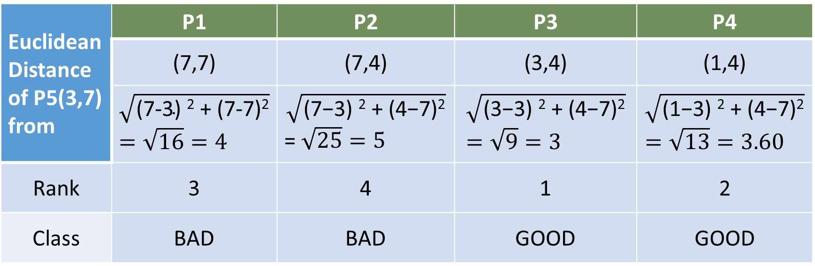
Points | X1 | X2 | Y
P1 | 7 | 7 | BAD
P2 | 7 | 4 | BAD
P3 | 3 | 4 | GOOD
P4 | 1 | 4 | GOOD
P5 | 3 | 7 | ?
KNN Example (3 Nearest NeighBour)
2 Good, 1 BAD -- so GOOD (majority voting)
Euclidean Distance of P5(3,7) from | P1 | P2 | P3 | P4
 | (7,7) | (7,4) | (3,4) | (1,4)
 | $$\sqrt{\text{(7−3) }\text{2}\text{ + (7−7)}\text{2}}=\sqrt{16}=4$$ | $$\sqrt{\text{(7−3) }\text{2}\text{ + (}\text{4}\text{−7)}\text{2}}$$ =$\sqrt{25}=5$ | $$\sqrt{\text{(}\text{3}\text{−3) }\text{2}\text{ + (}\text{4}\text{−7)}\text{2}}=\sqrt{9}=3$$ | $$\sqrt{\text{(}\text{1}\text{−3) }\text{2}\text{ + (}\text{4}\text{−7)}\text{2}}=\sqrt{13}=3.60$$
Rank | 3 | 4 | 1 | 2
Class | BAD | BAD | GOOD | GOOD

Slide 5
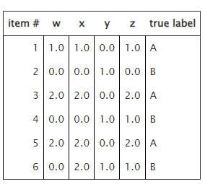
KNN Classification
Classify the data point: (<1, 0, 1, 2> using KNN with K=2 on the following dataset.
For k=2: k=rank=1, label=B
k=rank=2, label=B
class=B
Similarly:
For k=4:
k=rank=1, label=B
k=rank=2, label=B
k=rank=3, label=A
k=rank=4, label=B
As B’s occurrence is max, class=B

Slide 6
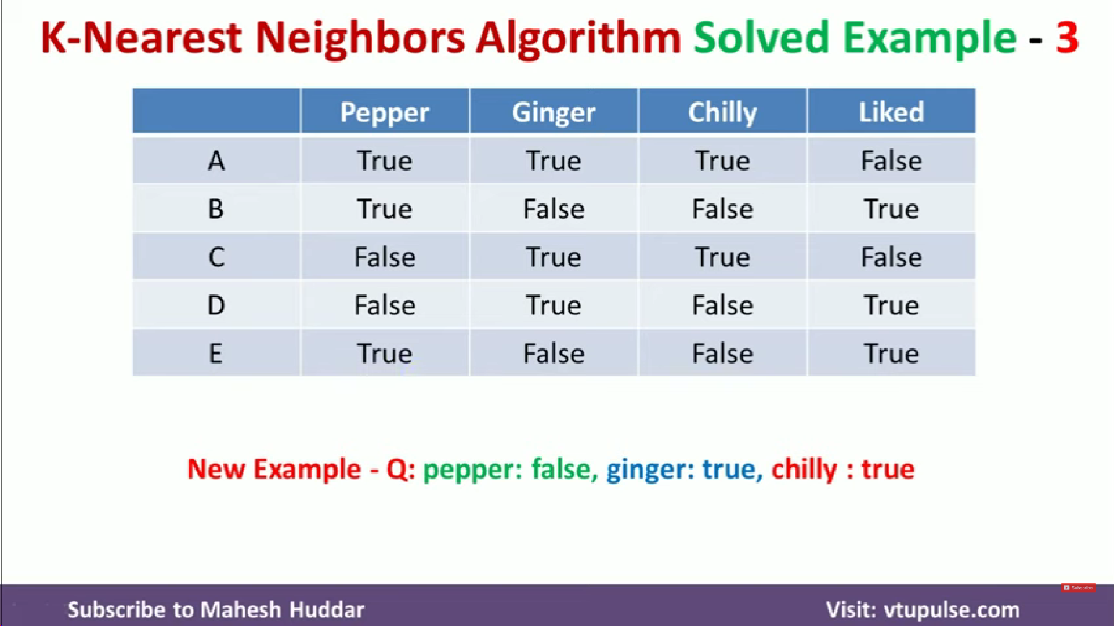

Slide 7
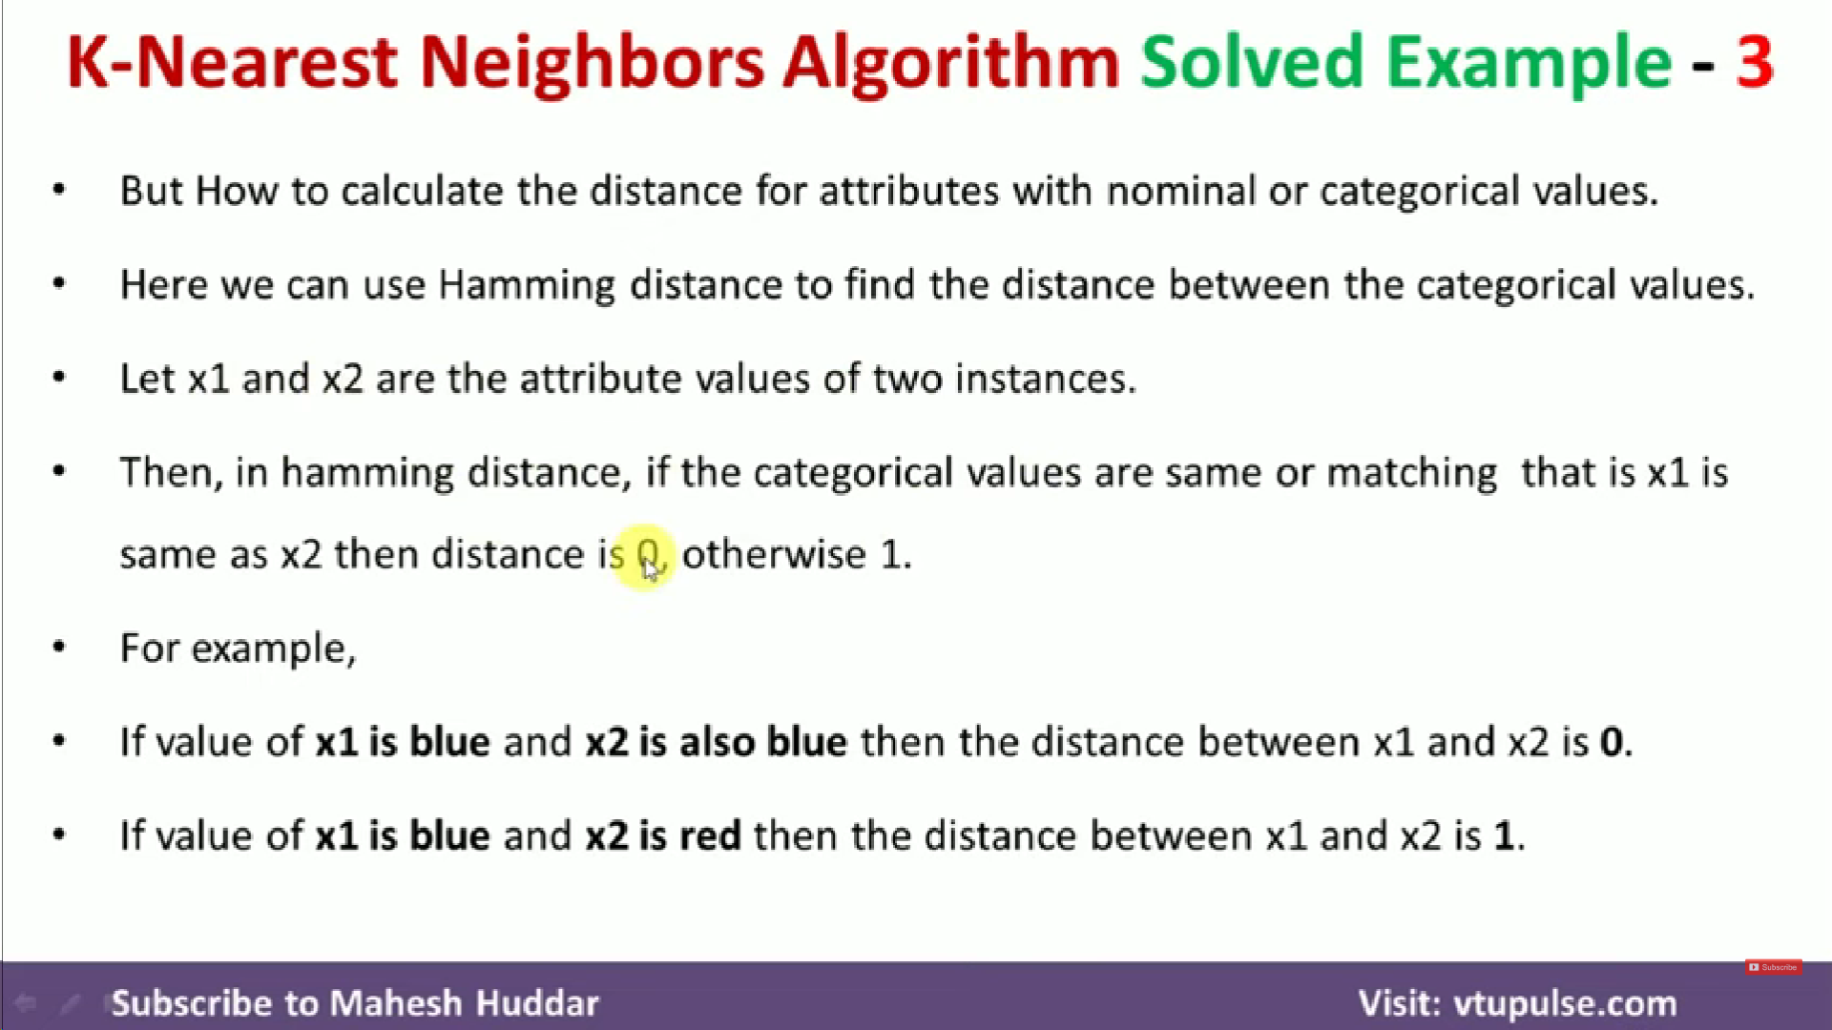

Slide 8
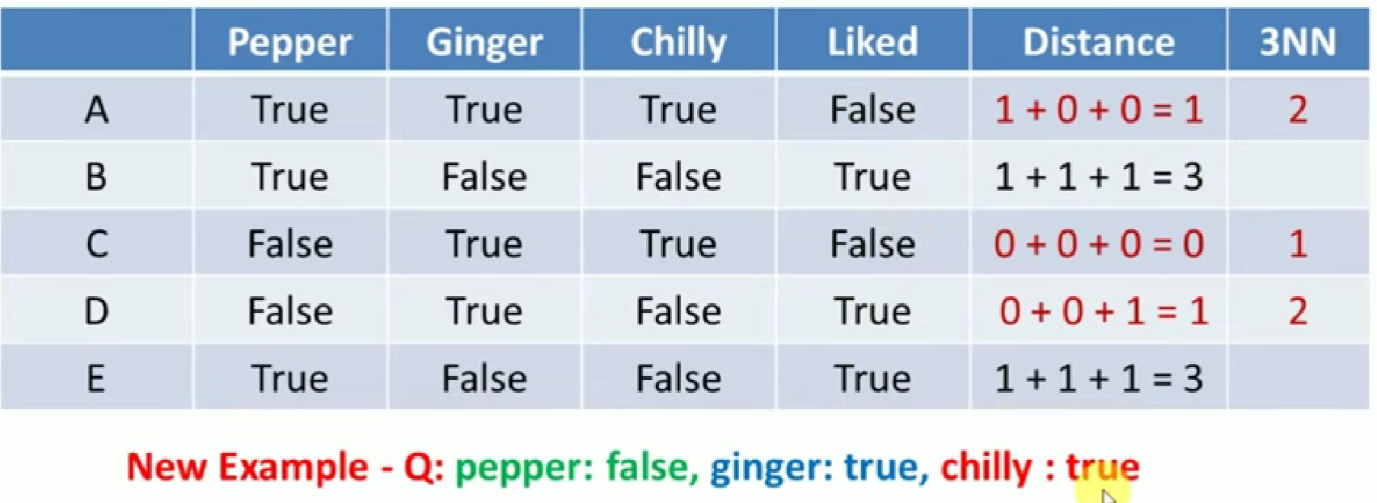
For A, Pepper = True but we need Pepper = False so Distance = 1
For A, Ginger = True but we need Ginger = True so Distance = 0
For A, Chilly = True but we need Chilly = True so Distance = 0
Therefore, final distance = 1 + 0 + 0 = 1
For k=2, maximum occurring class = False so class = False

